Slide 1
Plant Cells

Slide 2
Overview of Plant Structure
Plants are Earth’s Primary Producers
Harvest Energy from sunlight by converting light energy into chemical energy
They store this Chemical Energy in bonds formed when the synthesize Carbohydrates from Carbon Dioxide and Water.
Non- motile
Have evolved to grow towards resources throughout their life span.

Slide 3
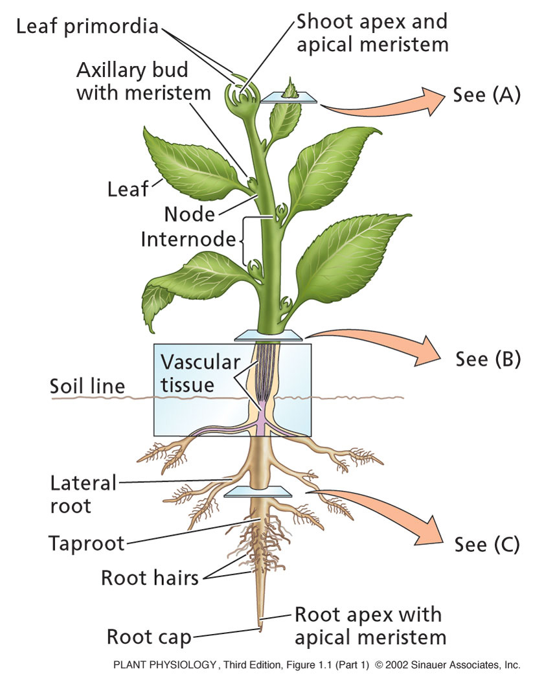
Overview of Plant Structure
The vegetative body consists of:
Leaf: Photosynthesis
Stem: Support
Roots: anchorage and absorption of water & minerals.
Nodes: leaf attached to stem.
Internode: Region of stem between two nodes

Slide 4
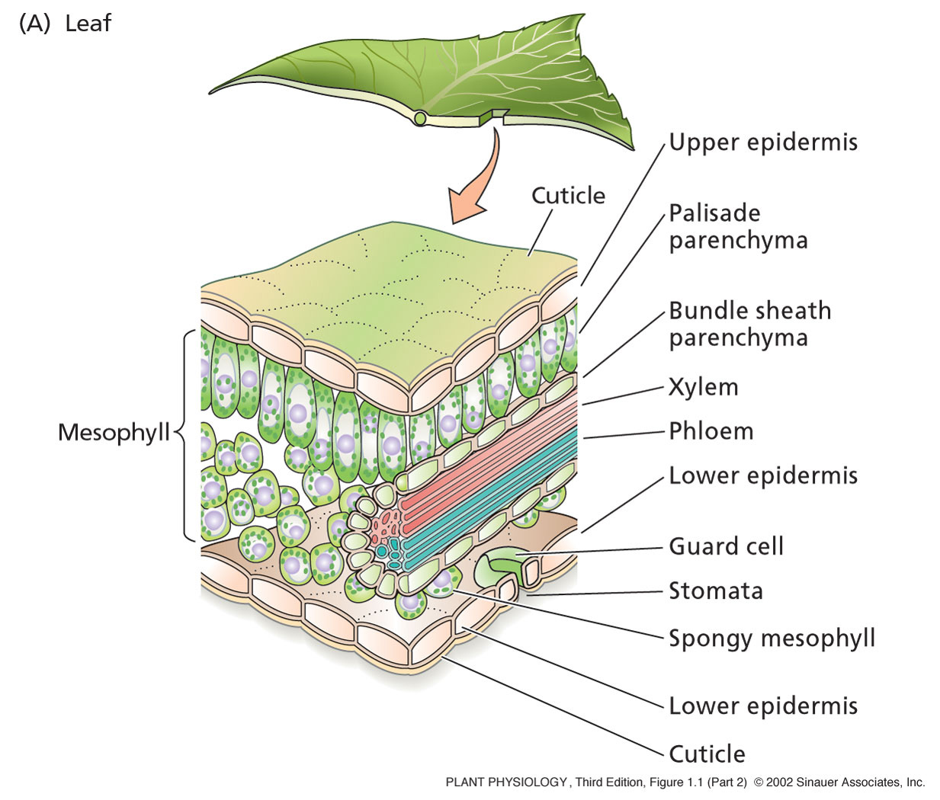
The leaf

Slide 5
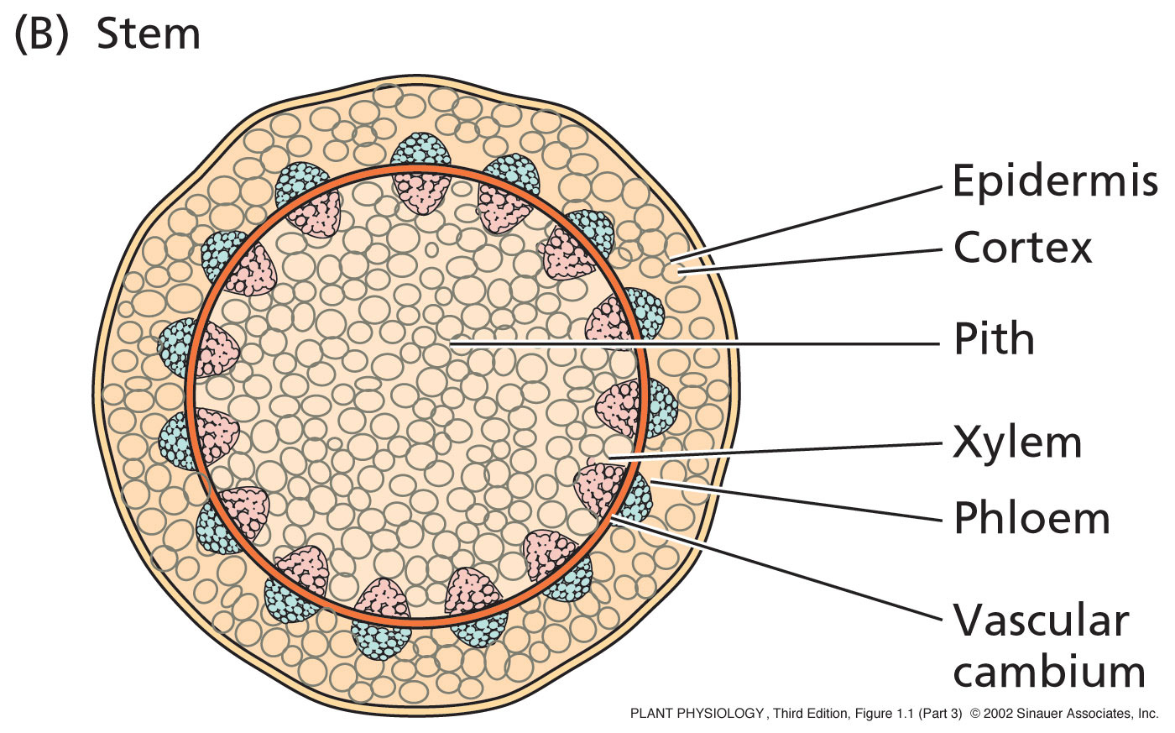
The stem

Slide 6
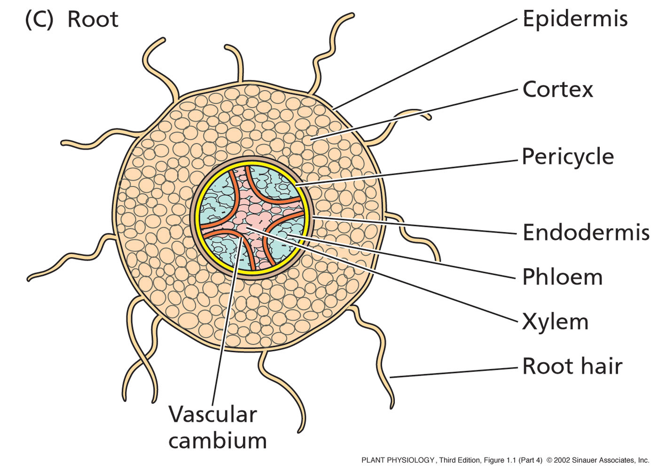
The Root

Slide 7
Overview of Plant Structure
Two general types of plants:
Angiosperms:
More advanced type of plant
About 250,000 species known
Major innovation is the Flower
So these are also known as flowing plants!
Gymnosperms:
Less advanced than angiosperms
About 700 species known
Largest group is the conifer (cone bearer)
ie, pine, fir, spruce, and redwood

Slide 8
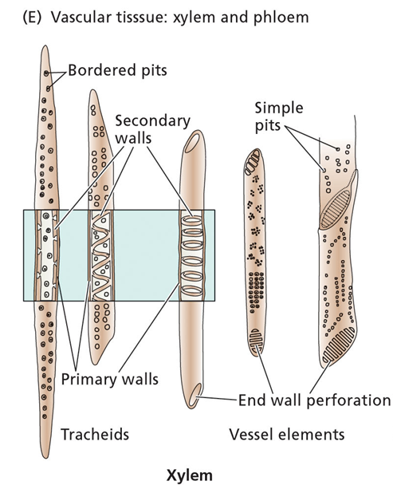
Overview of Plant Structure
Xylem:
Main water-conducting tissue of vascular plants.
arise from individual cylindrical cells oriented end to end.
At maturity the end walls of these cells dissolve away and the cytoplasmic contents die.
The result is the xylem vessel, a continuous nonliving duct.
carry water and some dissolved solutes, such as inorganic ions, up the plant

Slide 9
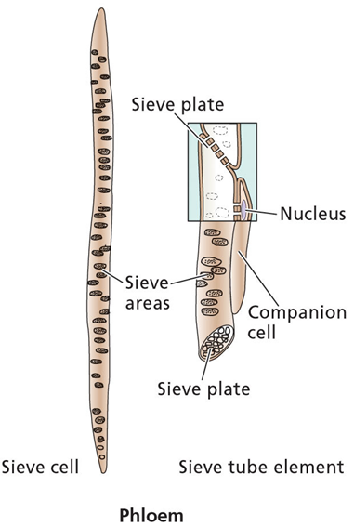
Overview of Plant Structure
Phloem:
The main components of phloem are
sieve elements
companion cells.
Sieve elements have no nucleus and only a sparse collection of other organelles . Companion cell provides energy
so-named because end walls are perforated - allows cytoplasmic connections between vertically-stacked cells .
conducts sugars and amino acids - from the leaves, to the rest of the plant

Slide 10
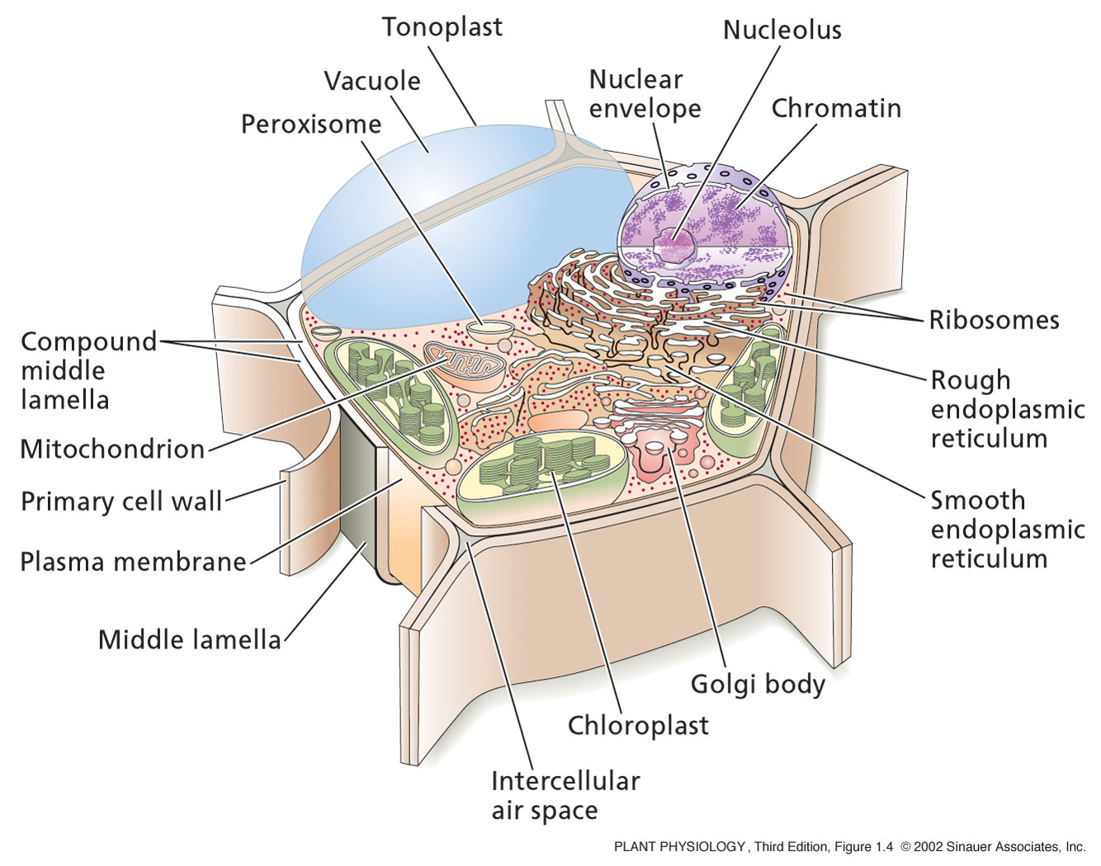
The Plant Cell

Slide 11
The Plant Cell
All plant cells have the same basic eukaryotic organization
However, at maturity when they become specialized, plant cells may differ greatly from one another in their structures and functions
Even those physically next to each other.
Even the nucleus can be lost in some plant cells
Contains many organelles with specific functions
Enclosed by a membrane which defines their boundaries
Don’t Forget the Cell Wall!!!!!!!!!!

Slide 12
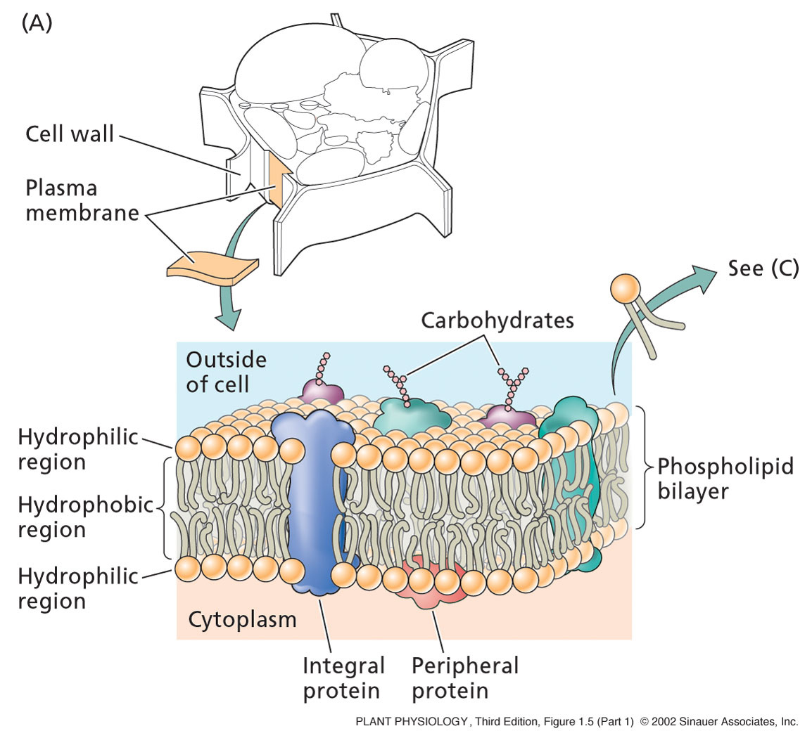
The Plasma Membrane
Composed of a phospholipid bilayer and proteins.
The phospholipid sets up the bilayer structure
Phospholipids have hydrophilic heads and fatty acid tails.
The plasma membrane is fluid--that is proteins move in a fluid lipid background

Slide 13
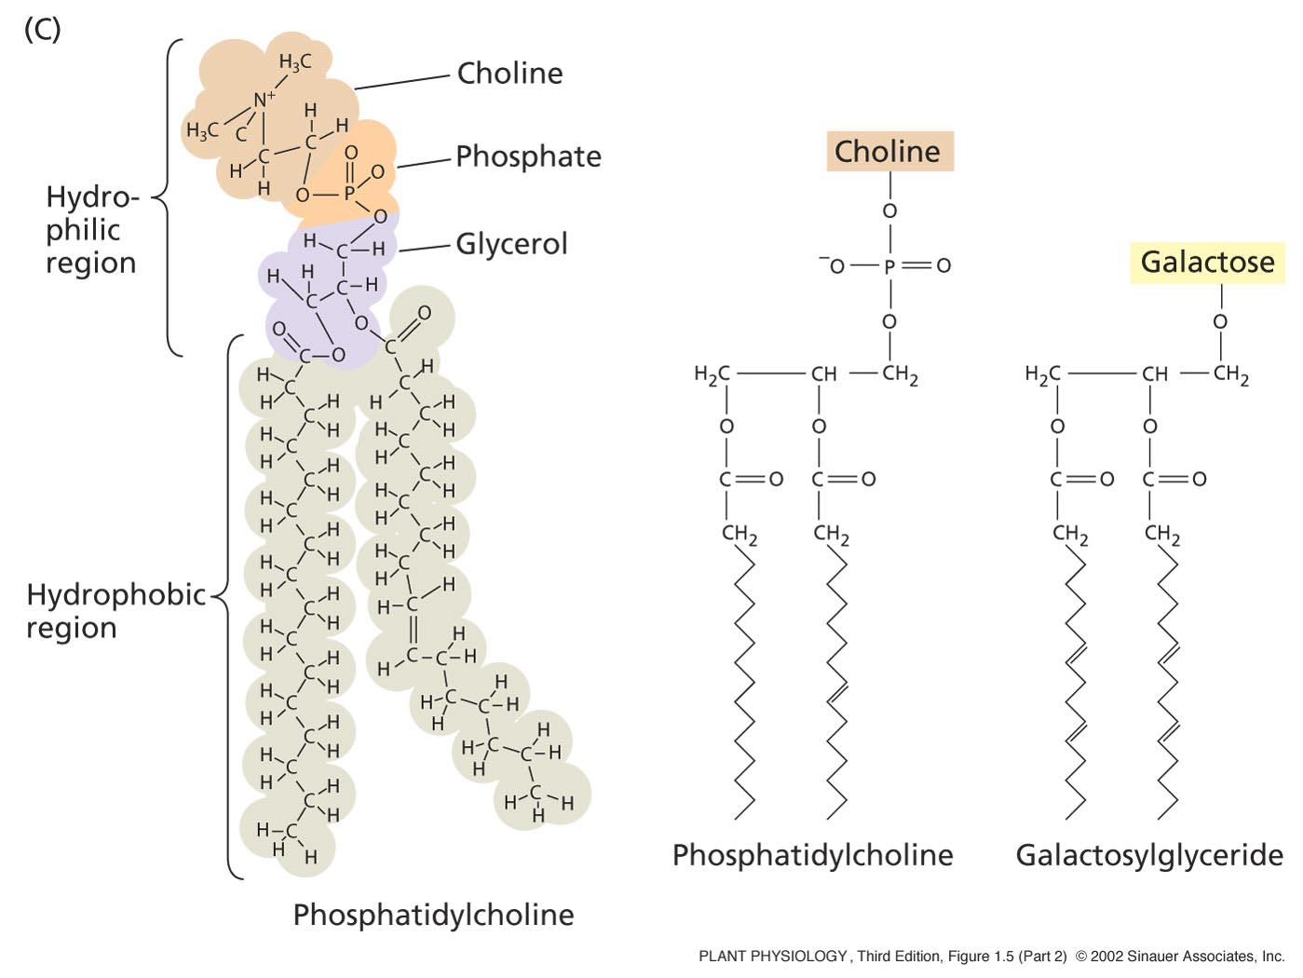
The Plasma Membrane
Phospholipids:
Two fatty acids covalently linked to a glycerol, which is linked to a phosphate.
All attached to a “head group”, such as choline, an amino acid.
Head group POLAR – so hydrophilic (loves water)
Tail is non-polar -hydrophobic
The tail varies in length from 14 to 28 carbons.

Slide 14
The Plasma Membrane
Proteins:
Integral proteins:
Embedded in lipid bylayer – serve as “ion pumps”
They pump ions across the membrane against their concentration gradient
Peripheral proteins:
Bound to membrane surface by ionic bonds.
Interact with components of the cytoskeleton
Anchored proteins:
Bound to surface via lipid molecules

Slide 15
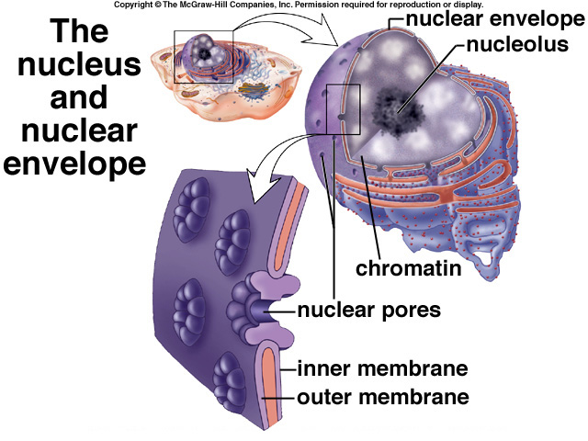
The nucleus
Contains almost all of the genetic material
What it contains is called the nuclear genome – this varies greatly between plant species.
Surrounded by nuclear envelope- double membrane - same as the plasma membrane.
The nuclear pores allow for the passage of macromolecules and ribosomal subunits in and out of the nucleus.

Slide 16
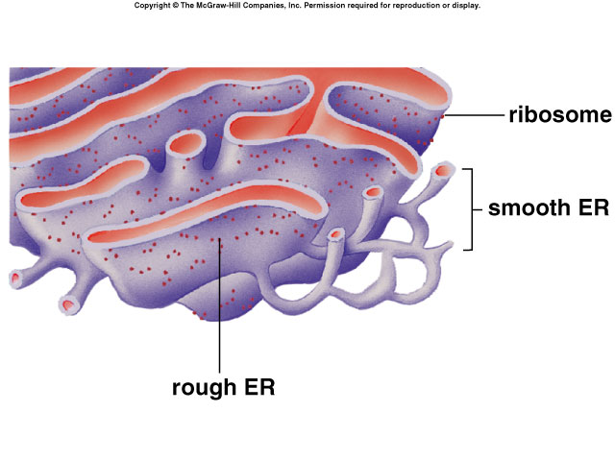
The Endoplasmic reticulum
Connected to the nuclear envelope
3D-network of continuous tubules that course through the cytoplasm.
Rough ER: Synthesize, process, and sort proteins targeted to membranes, vacuoles, or the secretory pathway.
Smooth ER: Synthesize lipids and oils.
Also:
Acts as an anchor points for actin filaments
Controls cytosolic concentrations of calcium ions

Slide 17
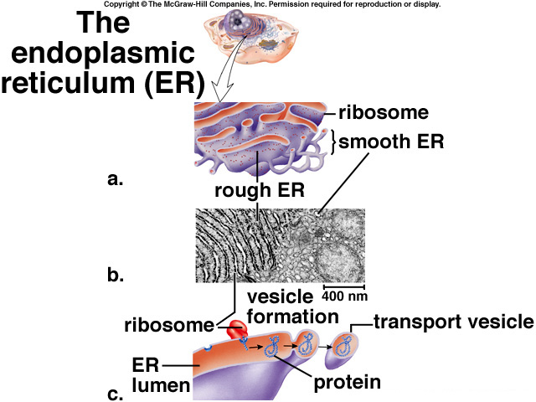
The Endoplasmic reticulum
Proteins are made in the Rough ER lumen by an attached ribosome.
Protein detaches from the ribosome
The ER folds in on itself to form a transport vesicle
This transport vesicle “buds off” and moves to the cytoplasm
Either:
Fuses with plasma membrane
Fuses with Golgi Apparatus

Slide 18
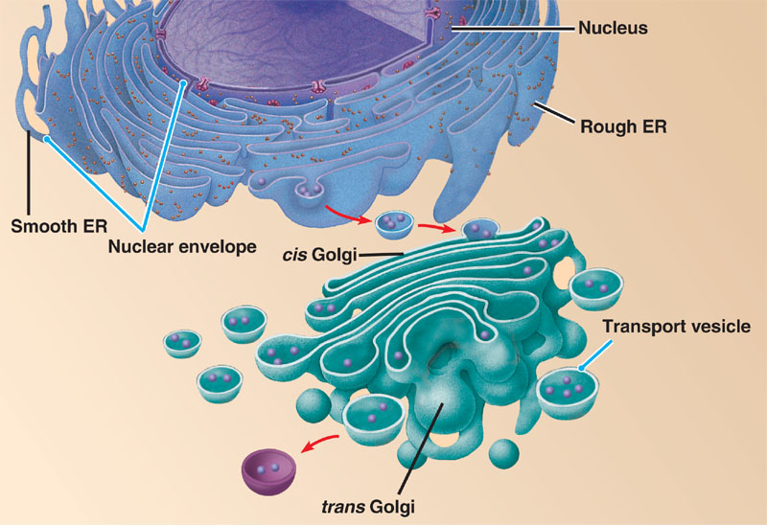
The Golgi Network
Proteins or lipids made in the ER contained in transport vesicles fuse with the Golgi.
The Golgi modifies proteins and lipids from the ER, sorts them and packages them into transport vesicles.
This transport vesicle “buds off” and moves to the cytoplasm.
Fuse with plasma membrane.

Slide 19
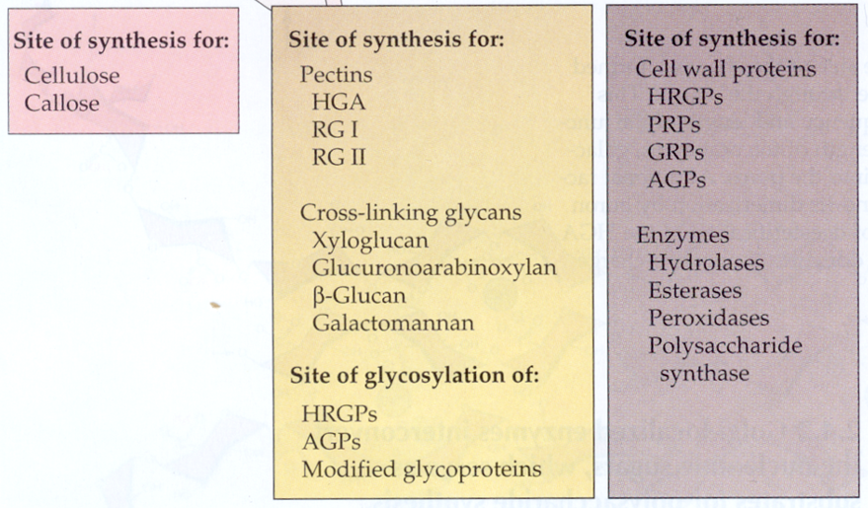
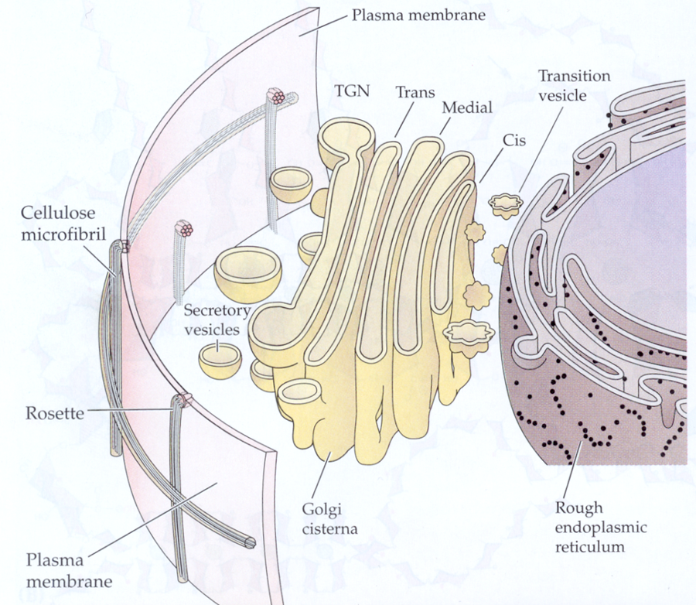
The Golgi Network

Slide 20
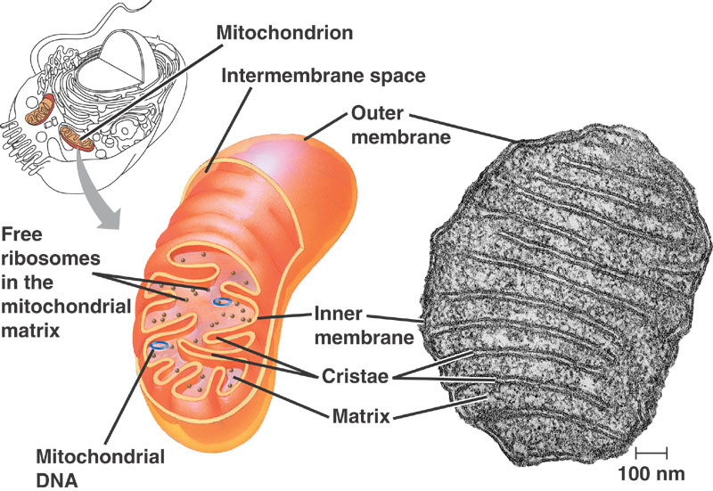
The Mitochondria
Contain their own DNA and protein-synthesizing machinery
Ribosomes, transfer RNAs, nucleotides.
Thought to have evolved from endosymbiotic bacteria.
Divide by fusion
The DNA is in the form of circular chromosomes, like bacteria
DNA replication is independent from DNA replication in the nucleus

Slide 21
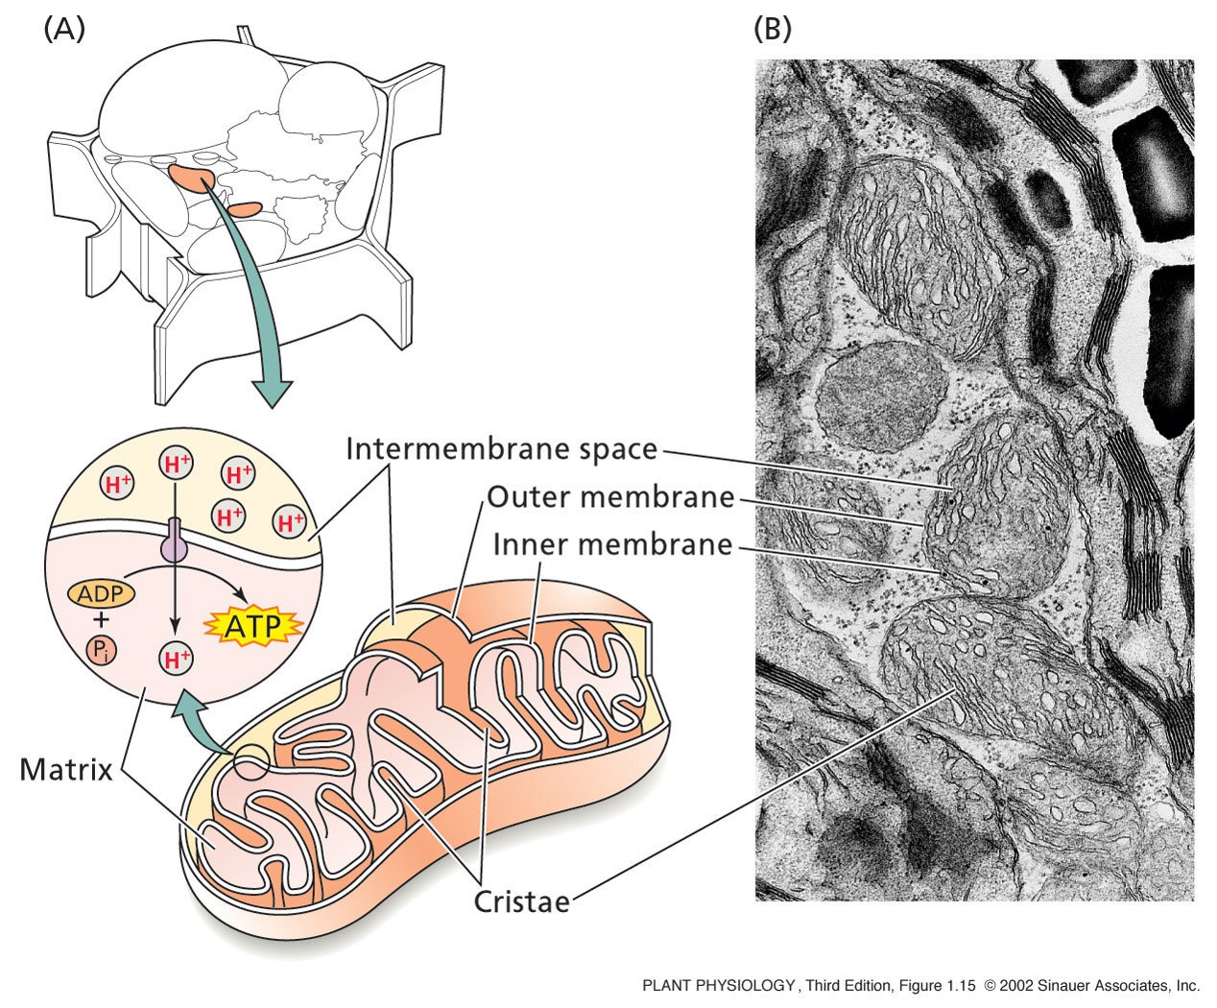
The Mitochondria
Site of Cellular Respiration
This process requires oxygen.
Composed of three stages:
Glycolysis--glucose splitting, occurs in the cell. Glucose is converted to Pyruvate.
Krebs cycle--Electrons are removed--carriers are charged and CO2 is produced. This occurs in the mitochondrion.
Electron transport--electrons are transferred to oxygen. This produces H2O and ATP. Occurs in the mito.

Slide 22
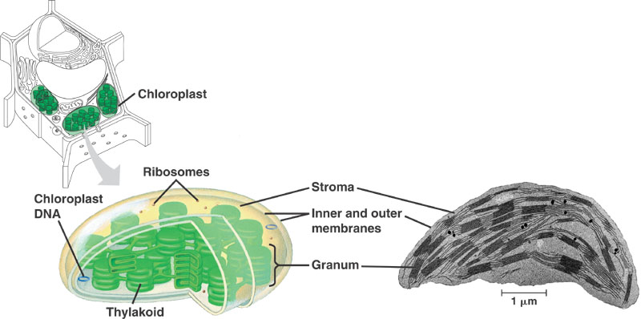
The Chloroplast
Contain their own DNA and protein-synthesizing machinery
Ribosomes, transfer RNAs, nucleotides.
Thought to have evolved from endosymbiotic bacteria.
Divide by fusion
The DNA is in the form of circular chromosomes, like bacteria
DNA replication is independent from DNA replication in the nucleus

Slide 23
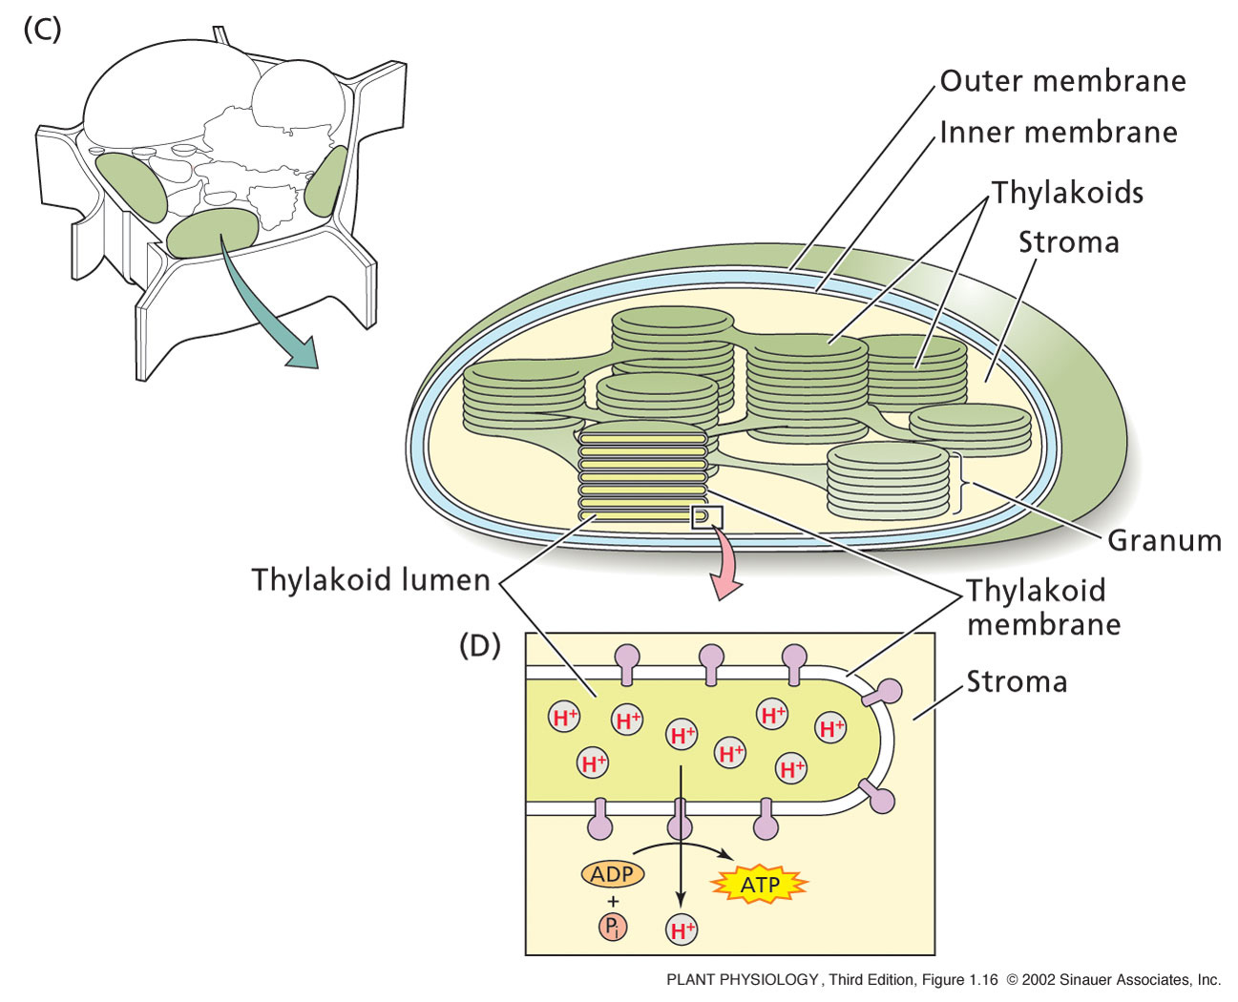
The Chloroplast
Membranes contain chlophyll and it’s associated proteins
Site of photosynthesis
Have inner & outer membranes
3rd membrane system
Thylakoids
Stack of Thylakoids = Granum
Surrounded by Stroma
Works like mitochondria
During photosynthesis, ATP from stroma provide the energy for the production of sugar molecules

Slide 24
The Vacuole
Can be 80 – 90% of the plant cell
Contained within a vacuolar membrane (Tonoplast)
Contains:
Water, inorganic ions, organic acids, sugars, enzymes, and secondary metabolites.
Required for plant cell enlargement
The turgor pressure generated by vacuoles provides the structural rigidity needed to keep herbaceous plants upright.

Slide 25
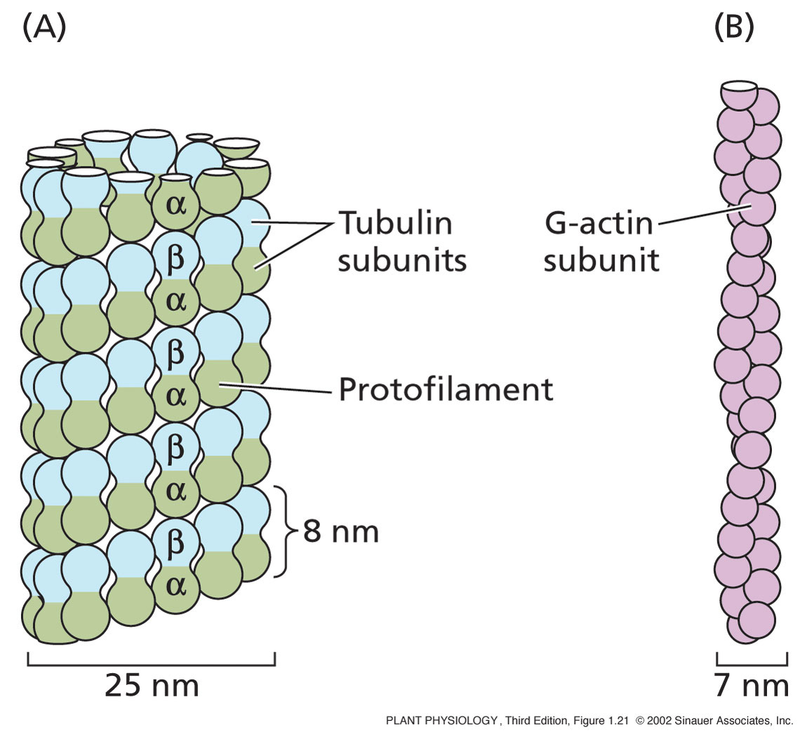
The cytoskeleton
Three main components:
Microtubules: are α and β proteins that create scaffolding in a cell. MTs are formed from the protein tubulin. 13 rows of tubulin =1 microtubule
Microfilaments: solid (7 nm) made from G-actin protein. Consists of 2 chains of actin subunits that intertwine in a helical fashion

Slide 26
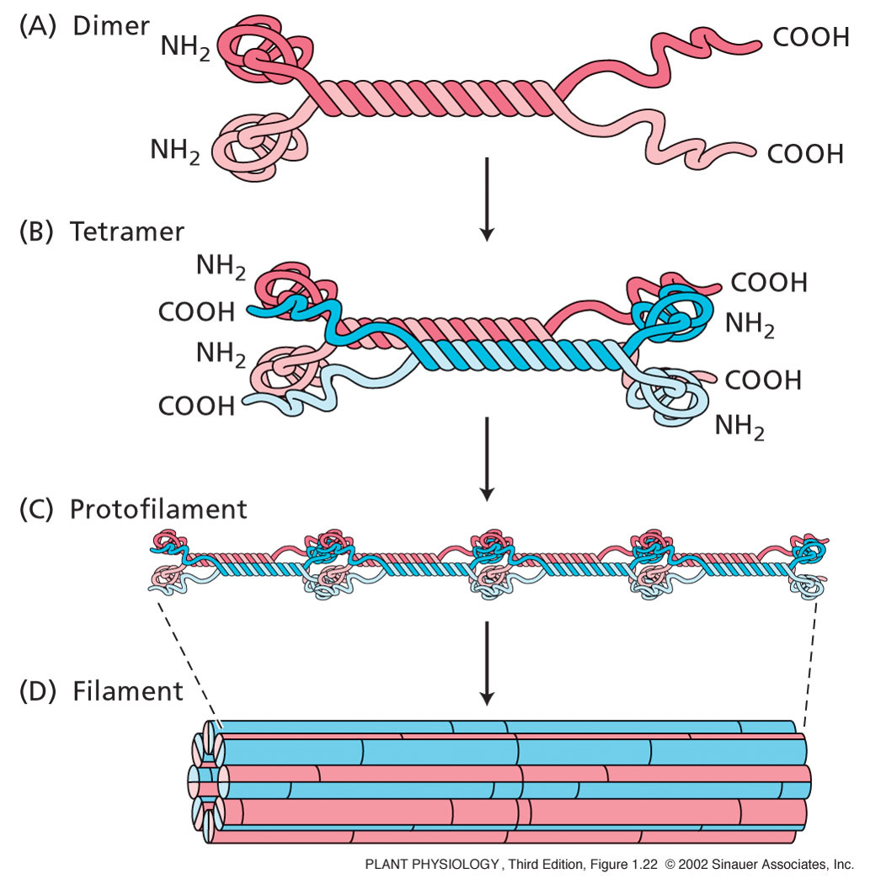
The cytoskeleton
Intermediate filaments: a diverse group of helically wound linear proteins.
Dimers line up parallel to each other
These form anti-parallel Tetramers
These join together to form a filament

Slide 27
The cytoskeleton
All these elements can assemble and disassemble
Involved in plant cell division
During mitosis
Process of division that produces two daughter cells with identical chromosomal content of parent cell

Slide 28
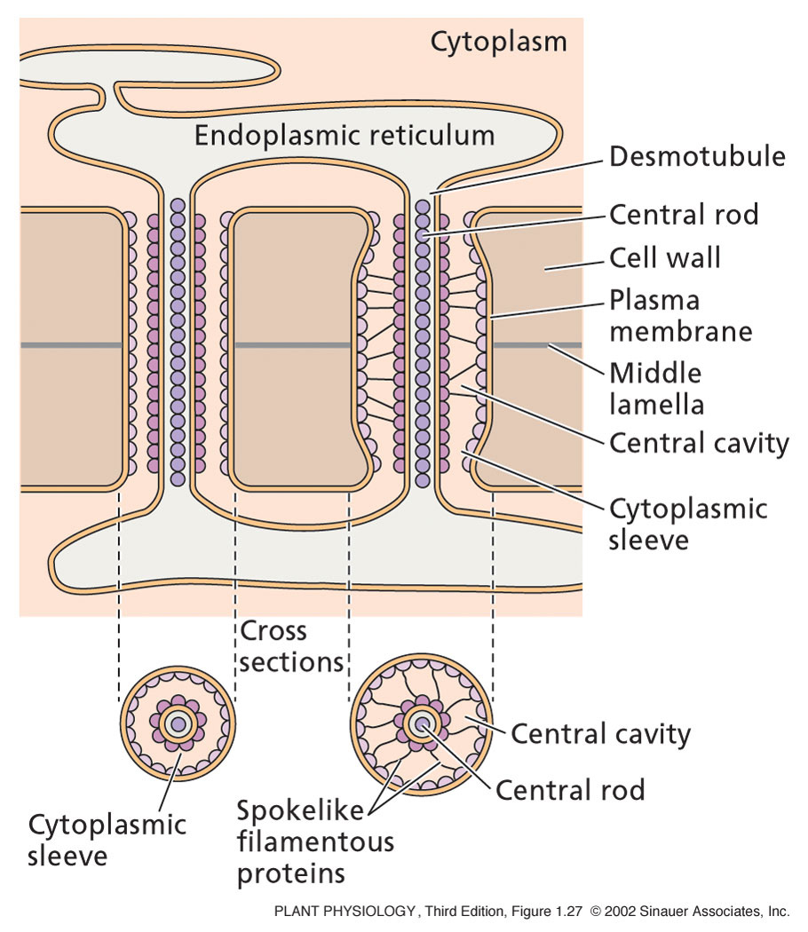
Plamodesmarta
Each contains a tube called a Desmotubule, which is part of the ER.
This is what connects adjacent cell and allow chemical communication and transport of material throughout the whole plant.
The restriction acts to control the size of the molecules which pass through.

Slide 29
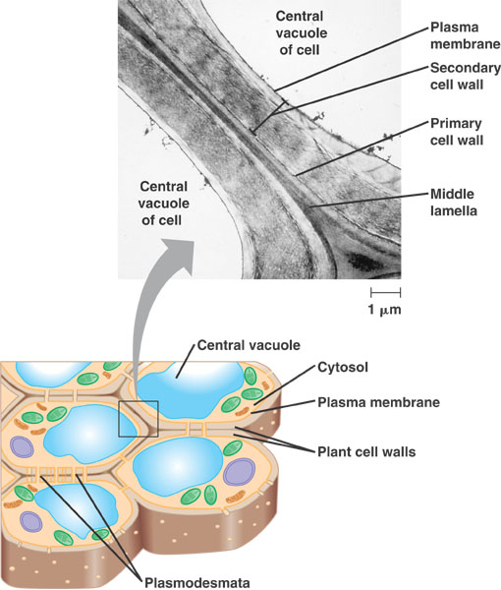
The Plant Cell wall
Cell walls are held together by the middle Lamella.
Made up of:
Cellulose
Xyloglucan
Pectin
Proteins
Ca ions
Lignin
other ions
Water

Slide 30
Replication of DNA

Slide 31
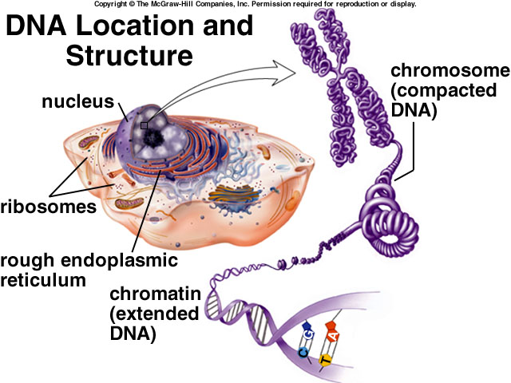
Composed of 4 nucleotide bases, 5 carbon sugar and phosphate.
Base pair = rungs of a ladder.
Edges = sugar-phosphate backbone.
Double Helix
Anti-Parallel

Slide 32
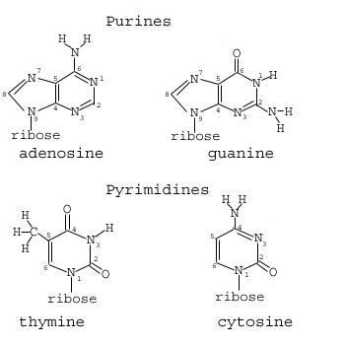
The bases
Chargaff’s Rules
A=T
G=C
led to suggestion of a double helix structure for DNA
Notes:
32

Slide 33
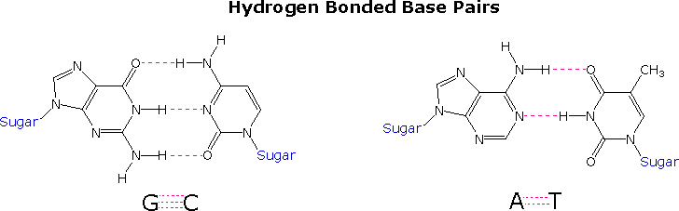
The Bases
Adenine (A) always base pairs with thymine (T)
Guanine (G) always base pairs with Cytosine (C)
Notes:
33

Slide 34
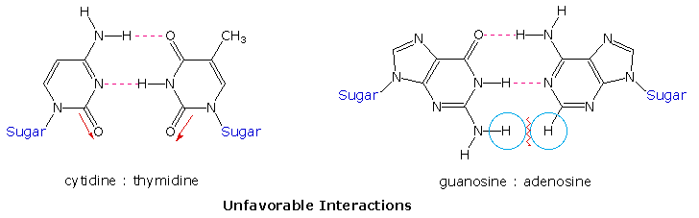
The Bases
The C#T pairing on the left suffers from carbonyl dipole repulsion, as well as steric crowding of the oxygens. The G#A pairing on the right is also destabilized by steric crowding (circled hydrogens).
Notes:
34

Slide 35
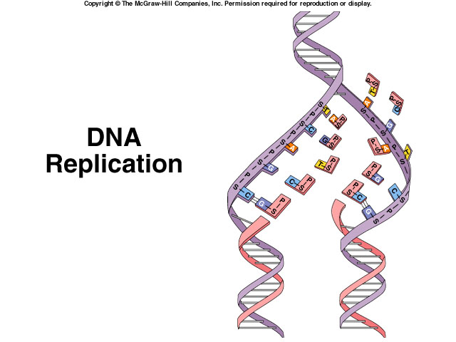

Slide 36
DNA Replication
Adenine (A) always base pairs with thymine (T)
Guanine (G) always base pairs with Cytosine (C)
ALL Down to HYDROGEN Bonding
Requires steps:
H bonds break as enzymes unwind molecule
New nucleotides (always in nucleus) fit into place beside old strand in a process called Complementary Base Pairing.
New nucleotides joined together by enzyme called DNA Polymerase

Slide 37
DNA Replication
Each new double helix is composed of an old (parental) strand and a new (daughter) strand.
As each strand acts as a template, process is called Semi-conservative Replication.
Replication errors can occur. Cell has repair enzymes that usually fix problem. An error that persists is a mutation.
This is permanent, and alters the phenotype.

Slide 38
Protein synthesis in Plants

Slide 39
Central Dogma of Molecular Biology
DNA holds the code
DNA makes RNA
RNA makes Protein
DNA to DNA is called REPLICATION
DNA to RNA is called TRANSCRIPTION
RNA to Protein is called TRANSLATION

Slide 40
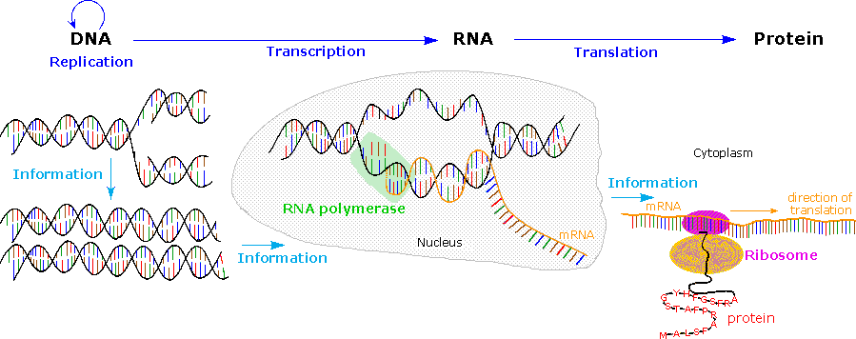
Central Dogma of Molecular Biology
Notes:
40

Slide 41
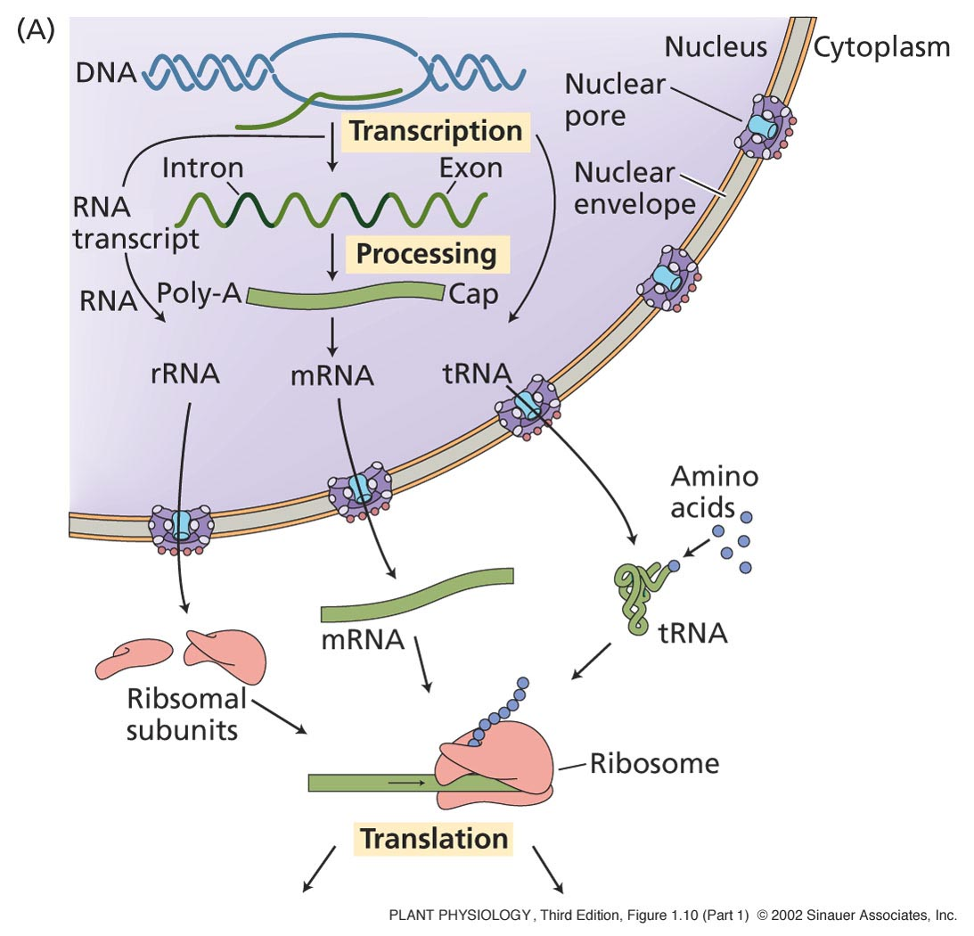
Summary of protein synthesis
Proteins:
Chains of Amino Acids
Three nucleotide base pairs code for one amino acid.
Proteins are formed from RNA
The nucleotide code must be translated into an amino acid code.

Slide 42
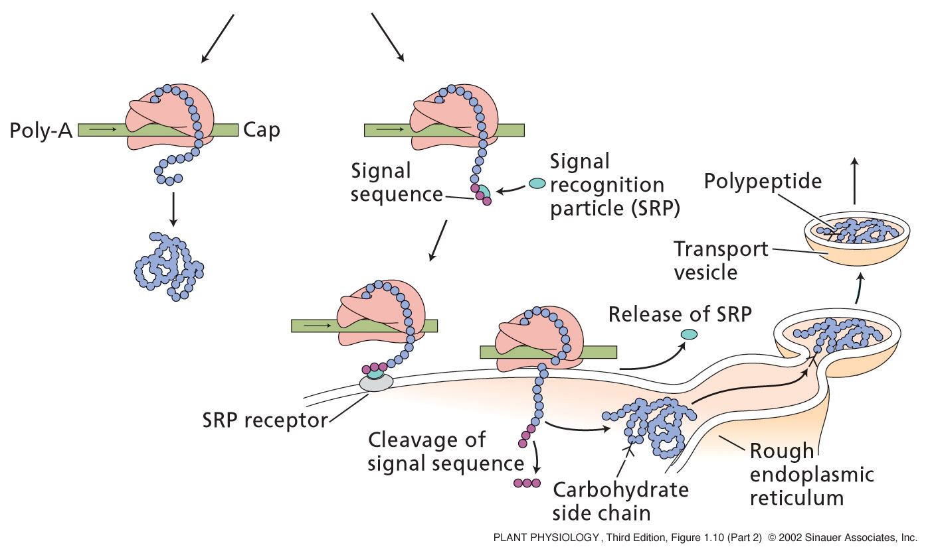
Occurs in the cytoplasm or on Rough ER

Slide 43
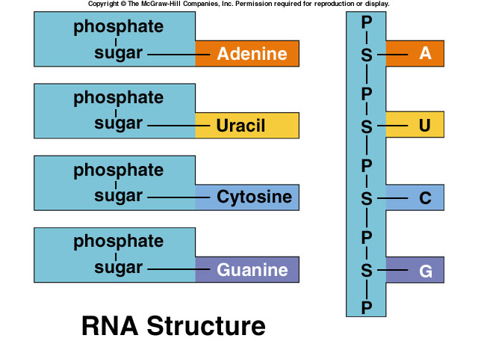
RNA
Formed from 4 nucleotides, 5 carbon sugar, phosphate.
Uracil is used in RNA.
It replaces Thymine
The 5 carbon sugar has an extra oxygen.
RNA is single stranded.

Slide 44
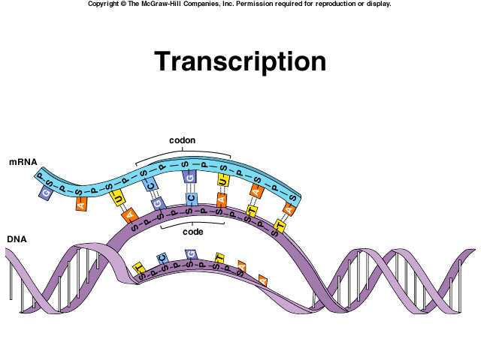

Slide 45
Translation
Translation requires:
Amino acids
Transfer RNA: (tRNA) Appropriate to its time, transfers AAs to ribosomes. The AA’s join in cytoplasm to form proteins. 20 types. Loop structure
Ribosomal RNA: (rRNA) Joins with proteins made in cytoplasm to form the subunits of ribosomes. Linear molecule.
Messenger RNA: (mRNA) Carries genetic material from DNA to ribosomes in cytoplasm. Linear molecule.

Slide 46
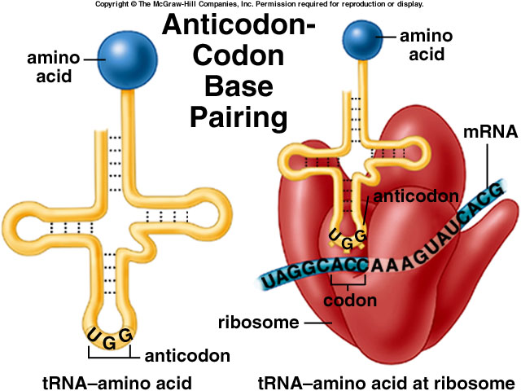

Slide 47
Translation
Initiation—
mRNA binds to smaller of ribosome subunits, then, small subunit binds to big subunit.
AUG start codon--complex assembles
Elongation—
add AAs one at a time to form chain.
Incoming tRNA receives AA’s from outgoing tRNA. Ribosome moves to allow this to continue
Termintion— Stop codon--complex falls apart

Slide 48
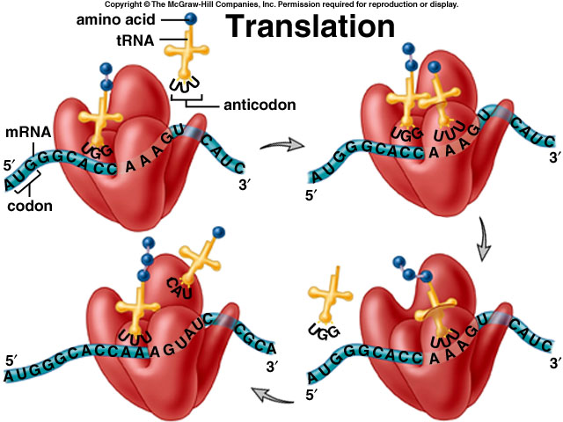

Slide 49
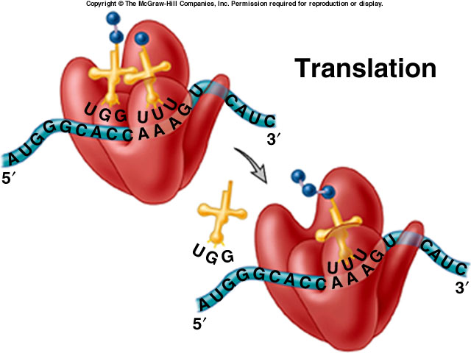

Slide 50
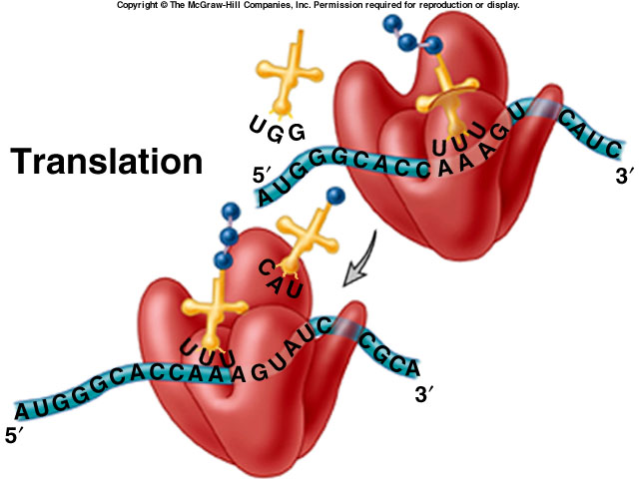

Slide 51
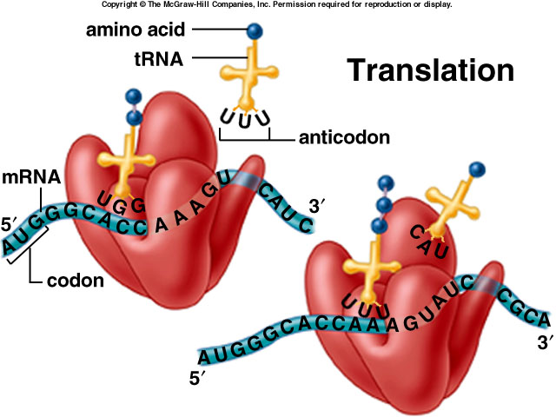

Slide 52
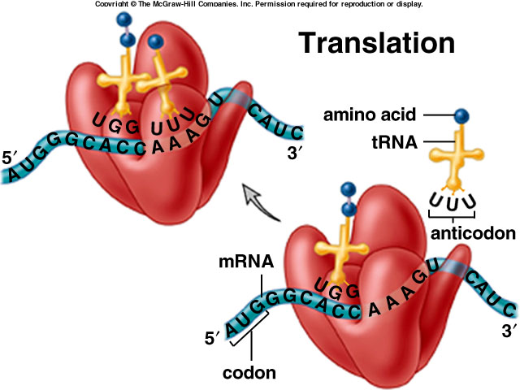

Slide 53
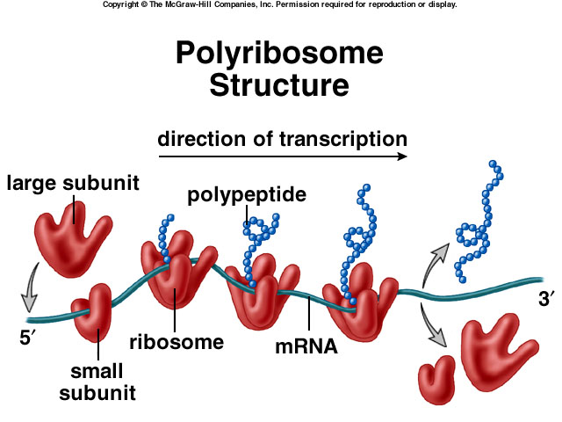

Slide 54
Translation
Translation requires:
Amino acids
Transfer RNA: (tRNA) Appropriate to its time, transfers AAs to ribosomes. The AA’s join in cytoplasm to form proteins. 20 types. Loop structure
Ribosomal RNA: (rRNA) Joins with proteins made in cytoplasm to form the subunits of ribosomes. Linear molecule.
Messenger RNA: (mRNA) Carries genetic material from DNA to ribosomes in cytoplasm. Linear molecule.

Slide 55
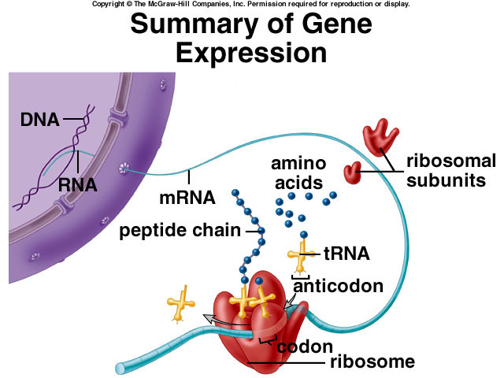

Slide 56
Cell Division in Plants

Slide 57
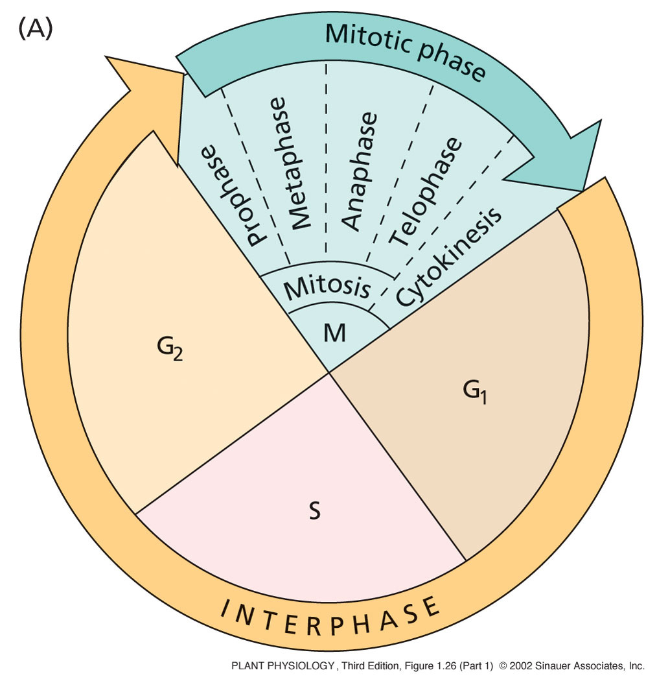
Most plant cells divide by Mitosis
Mitosis: Process of division that produces two daughter cells with identical chromosomal content of parent cell.
Mitosis is one stage of the cell cycle.
Cell cycle--cycle of stages a cell goes through in order to grow and divide.

Slide 58
Stages of Division
Prophase--nuclear envelope breakdown, chromosome condensation, spindle formation.
Metaphase--chromosomes are lined up precisely on the metaphase plate, or middle of the cell.
Anaphase--spindle pulls sister chromatids apart.
Telophase--chromatids begin to decondense and become chromatin. Spindle disappears.
Cytokinesis--divide cell and organelles. Actin ring, or cleavage furrow splits cell.

Slide 59
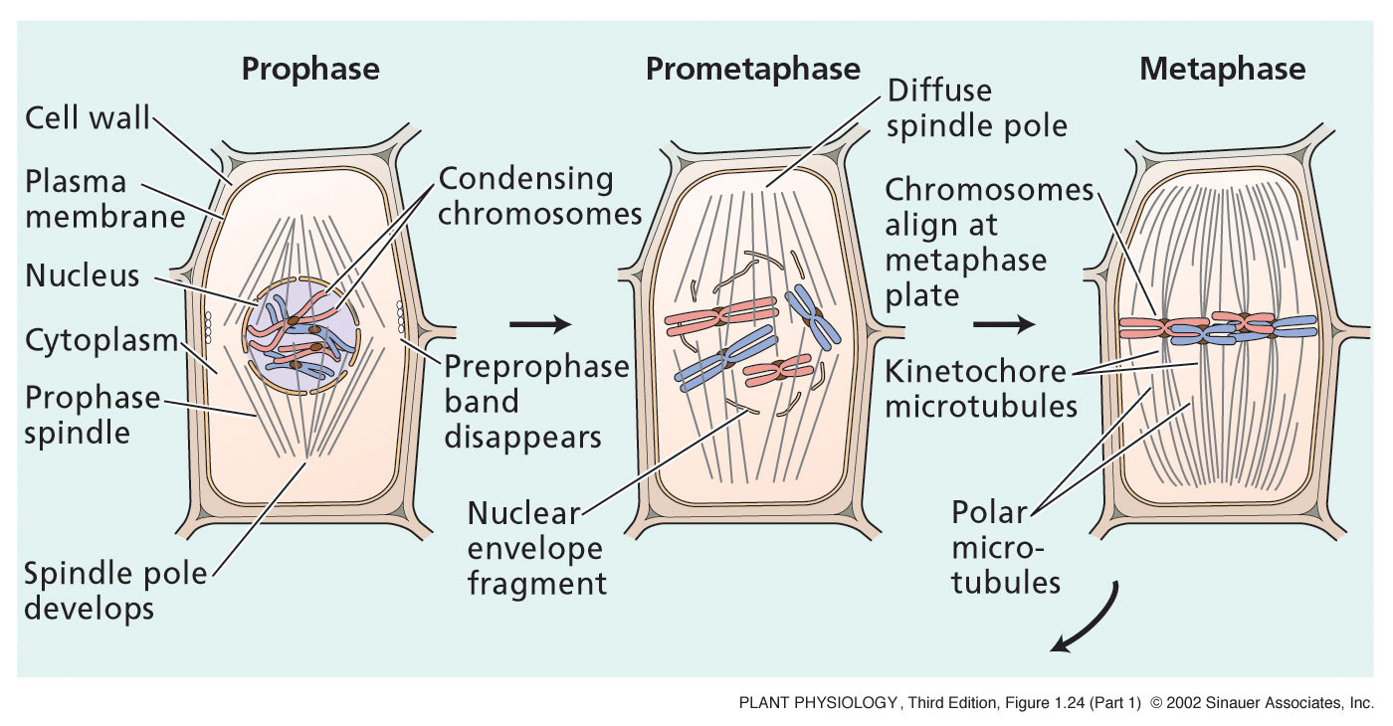
Prophase--nuclear envelope breakdown, chromosome condensation, spindle formation.
Metaphase--chromosomes are lined up precisely on the metaphase plate, or middle of the cell.

Slide 60
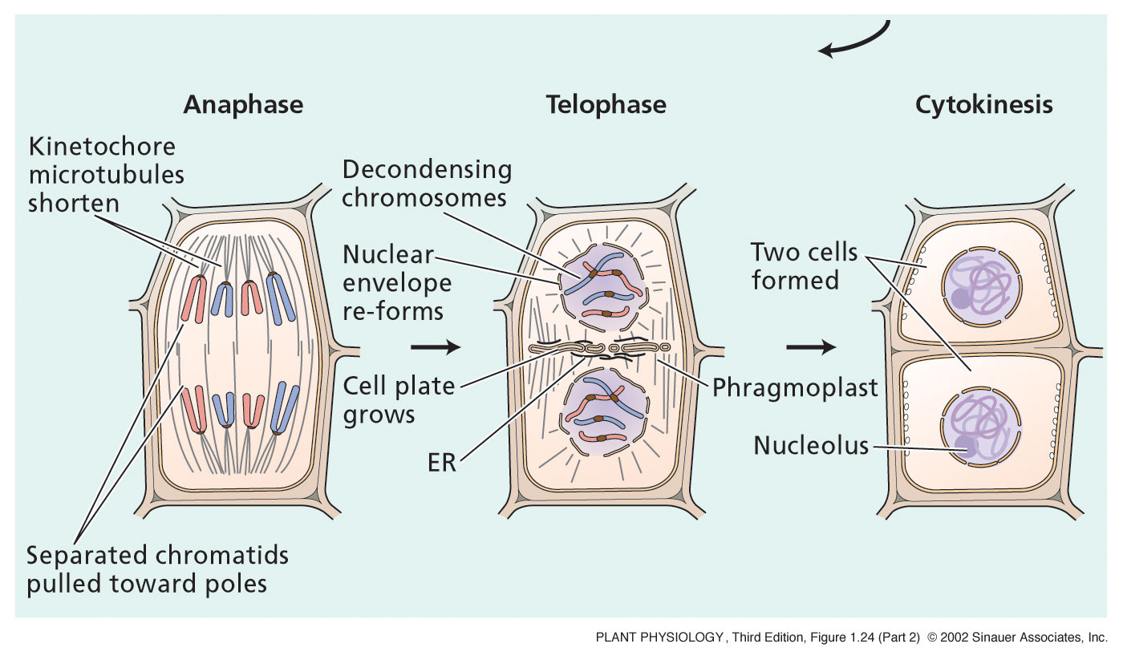
Anaphase--spindle pulls sister chromatids apart.
Telophase--chromatids begin to decondense and become chromatin. Spindle disappears.
NEW CELL WALL IS FORMED
Cytokinesis--divide cell and organelles. Actin ring, or cleavage furrow splits cell.

Slide 61
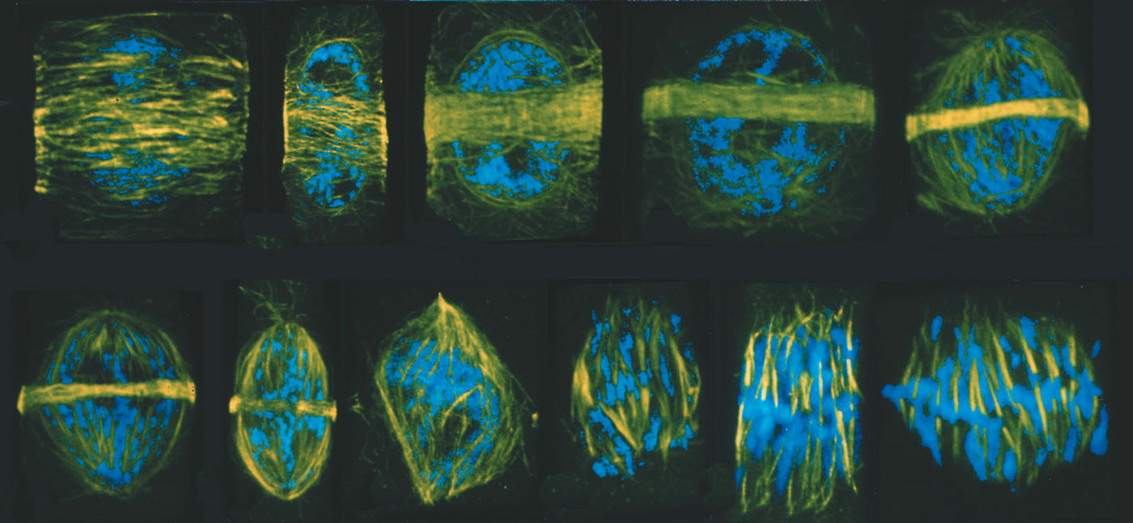
Remember the cytoskeleton?
Changes in microtubule arrangements (yellow) during different stages of the cell cycle of wheat root cells. DNA is shown in blue.

Slide 62
ANY QUESTIONS?

